Slide 1
New customer acquisition powered by Machine learning
Prepared by : Ishu Srivastava

Slide 2
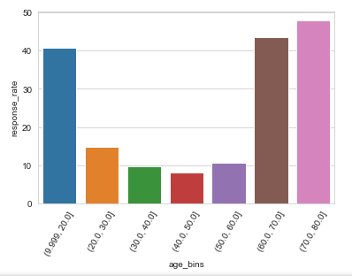
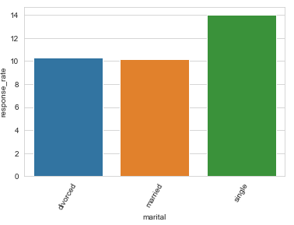
Interesting Insights of Data
Youngest and the Eldest population, more interested in savings
Singles can surely spare more money for savings as compared to others

Slide 3
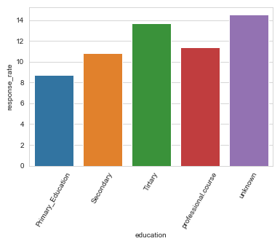
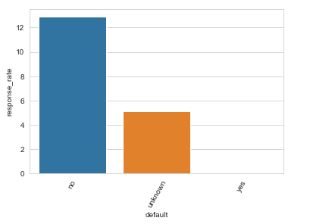
One’s interest in saving increases with his education.
Surprisingly Professionals don’t have enough money for saving!!
You defaulted once, we will not even bother to ask you for savings

Slide 4
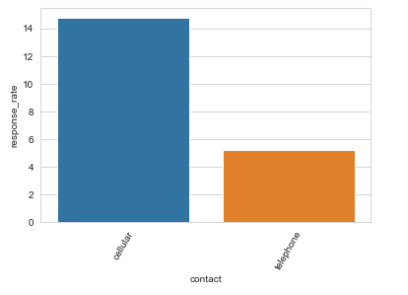
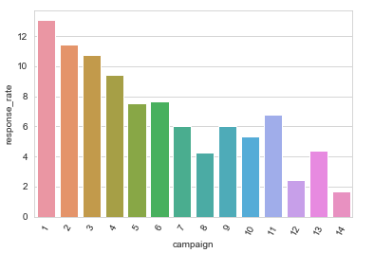
People sitting idle around telephones are lazy for their saving plans as well
Customers having prejudice and the wrong perception about the bank will not trust on you for their savings

Slide 5
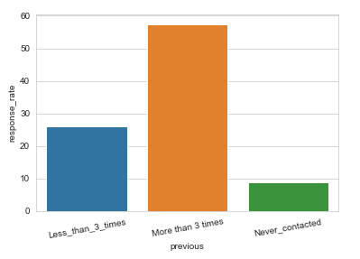
More times one contacted, more the changes of him to respond positively

Slide 6
Regular Approach
Call the random prospects based on the judgment of human being
This judgment can be biased and be incorrect
Can be ending up calling the whole prospect population, in order to meet business objective
Cost is too high
Can lead to wastage of marketing budgets

Slide 7
ML Approach
Split the Data at disposal into Train(from which the ML model will learn) and Test (Dataset on which the learning from Train is applied and validated).
Transform the Train set to Principal Components and select the top principal components explaining the maximum variance of the data.
Develop a logistic regression ML model to learn from principal components of test data.
Make the predication using the ML model for different probabilities(starting from 0.1 to 0.9)

Slide 8
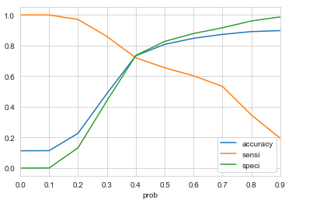
Plot the selectivity, sensitivity and specificity for different probabilities
Find the optimum probability by finding
the intersection point of these 3 metrics
Predict the conversion(1) or non-conversion(0) based on the optimum probability for test set
Calculate the various evaluation metrics on test set.
Convert the Test set to principal components
Apply the model,predict the conversion and calculate the same evaluation metrics and compare with Train metrics

Slide 9
Sort the Test data by decreasing probabilities and divide it into 10 equal sized chunks(Deciles).
Calculate the actual conversion count and percentage of conversion in each deciles.
Also calculate Cumulative % conversion in each decile.
Find the top deciles which will cover our business objective of conversion(In our case it was top 5 deciles, covering 80% of the conversion)

Slide 10
Magic of ML
Predict the probability of someone’s response like reading their mind
People having more than 40% probability of conversion must be targeted

Slide 11
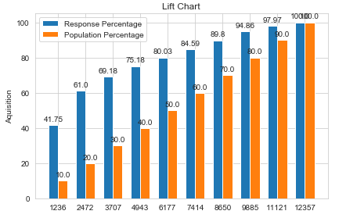
Time Saving
ML enables to get the 75% conversions just by approaching to 40% population

Slide 12
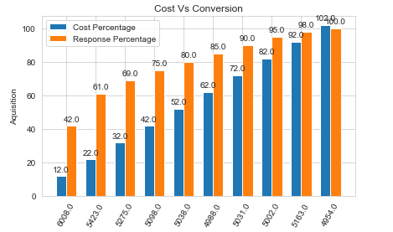
Cost Saving
Just spending around 42% allotted expense, 75% response rate can be achieved.

Slide 13
Summary
So ML enables us to identify the most promising targets.
Help us focusing and channelizing our efforts.
Reduce the Cost in terms of time and efforts
And most importantly help the business to save few bucks and gives a competitive edge over other banks

